Slide 1
Network Security
understand principles of network security:
  cryptography and its many uses beyond “confidentiality”
  authentication
  message integrity
Network Security

Slide 2
Chapter 8 roadmap
8.1 What is network security?
8.2 Principles of cryptography
8.3 Message integrity, authentication
Network Security

Slide 3
What is network security?
confidentiality: only sender, intended receiver should “understand” message contents
  sender encrypts message
  receiver decrypts message
authentication: sender, receiver want to confirm identity of each other
message integrity: sender, receiver want to ensure message not altered (in transit, or afterwards) without detection
access and availability: services must be accessible and available to users
Network Security

Slide 4



Friends and enemies: Alice, Bob, Trudy
well-known in network security world
Bob, Alice (lovers!) want to communicate “securely”
Trudy (intruder) may intercept, delete, add messages
Alice
Bob
channel
data, control messages
secure
sender
s
data
secure
receiver
data
Trudy
Network Security

Slide 5
Who might Bob, Alice be?
… well, real-life Bobs and Alices!
Web browser/server for electronic transactions (e.g., on-line purchases)
on-line banking client/server
DNS servers
routers exchanging routing table updates
other examples?
Network Security

Slide 6
There are bad guys (and girls) out there!
Q: What can a “bad guy” do?
A: A lot! See section 1.6
  eavesdrop: intercept messages(to listen to someone's private conversation without them knowing)
  actively insert messages into connection
  impersonation: can fake (spoof) source address in packet (or any field in packet)
  hijacking: “take over” ongoing connection by removing sender or receiver, inserting himself in place
  denial of service: prevent service from being used by others (e.g., by overloading resources)
Network Security

Slide 7
Chapter 8 roadmap
8.1 What is network security?
8.2 Principles of cryptography
8.3 Message integrity, authentication
8.4 Securing e-mail
8.5 Securing TCP connections: SSL
8.6 Network layer security: IPsec
8.7 Securing wireless LANs
8.8 Operational security: firewalls and IDS
Network Security

Slide 8

The language of cryptography
Alice’s
encryption
key
Bob’s
decryption
key
K
K
A
B
plaintext
encryption
algorithm
ciphertext
decryption
algorithm
plaintext
m plaintext message
K_{A}(m) ciphertext, encrypted with key K_{A}
m = K_{B}(K_{A}(m))
Network Security

Slide 9
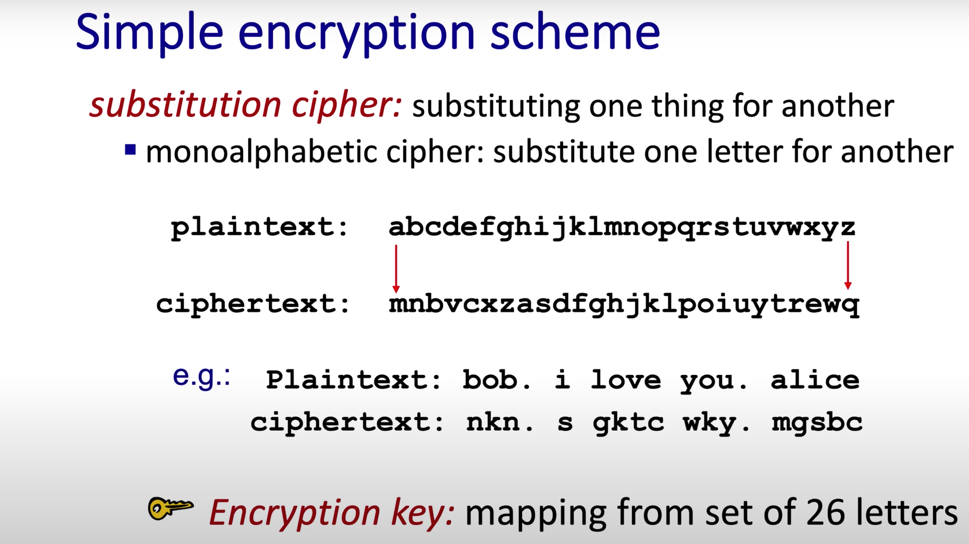
Network Security

Slide 10
Cryptography: Basic Terminology
Plaintext (or cleartext)
  The message.
  Denoted by M or P.
Encryption (encipher)
  Encoding of message.
  Denoted by E.
Ciphertext
  Encrypted message.
  Denoted by C.
Decryption (decipher)
  decoding of ciphertext
  denoted by D.
EMTM 553
4/20/01

Slide 11
Encryption and Decryption
M
C
M
E
D
The following identity must hold true:
D(C) = M, where C = E(M)
EMTM 553
4/20/01

Slide 12
Key Based Encryption/Decryption
K₁
K₂
M
C
M
E
D
Symmetric Case: both keys are the same or derivable from each other.
Asymmetric Case: keys are different and not derivable from each other.
EMTM 553
4/20/01

Slide 13
1. Secrete Key Cryptography
K
K
M
C
M
S
E
D
R
K is the secret key shared by both the
sender (S) and receiver (R).
EMTM 553
4/20/01

Slide 14
Secrete Key Cryptography
Also called symmetric or single-key algorithms.
  The encryption and the decryption key are the same.
Techniques based on a combination of substitution and permutation.
Stream ciphers: operate on single bit or byte.
Block ciphers: operate on blocks (typically 64 bits)
Advantage: simple, fast.
Disadvantage: key exchange, key management.
Examples: DES,RC4, IDEA, Blowfish, AES, etc.
EMTM 553
4/20/01

Slide 15
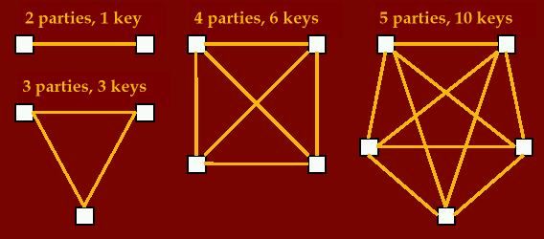
Symmetric Key - Issues
Key management, keys required = (p*(p-1))/2 or:
EMTM 553
4/20/01

Slide 16
Secrete Key Assurances
Confidentiality
  is assurance that only owners of a shared secrete key can decrypt a message that has been encrypted with the shared secrete key
Authentication
  is assurance of the identify of the person at the other end of the line (use challenge and response protocols)
Integrity
  is assurance that a message has not been changed during transit and is also called message authentication (use message fingerprint)
Non-repudiation
  is assurance that the sender cannot deny a file was sent. This cannot be done with secrete key alone (need trusted third party or public key technology)
EMTM 553
4/20/01

Slide 17
2. Public Key Cryptography
K_{R(pub)}
K_{R(pri)}
M
C
M
S
E
D
R
K_{R(pub)} is Receiver’s public key and K_{R(pri)} is Receiver’s private key.
EMTM 553
4/20/01

Slide 18
Problem Statement
Suppose Alice has an channel for communicating with Bob.
Alice and Bob wish to use this channel to established a shared secret.
However, Eve is able to learn everything sent over the channel.
If Alice and Bob have no other channel to use, can they establish a shared secret that Eve does not know?
EMTM 553
4/20/01

Slide 19
General Strategy
A public key is used to encrypt a message that can be decrypted only by the matching private key.
Bob can use Alice’s public key to encrypt messages. Only Alice can decrypt the message.
  Similarly, Alice can also use Bob’s public key.
4/20/01

Slide 20

Public Key Cryptography
symmetric key crypto
requires sender, receiver know shared secret key
Q: how to agree on key in first place (particularly if never “met”)?
public key crypto
radically different approach [Diffie-Hellman76, RSA78]
sender, receiver do not share secret key
public encryption key known to all
private decryption key known only to receiver
Network Security

Slide 21
Public key cryptography
+
Bob’s public
key
K
B
-
Bob’s private
key
K
B
plaintext
message, m
encryption
algorithm
ciphertext
decryption
algorithm
plaintext
message
+
K (m)
-
+
B
m = K (K (m))
B
B
Network Security

Slide 22
Asymmetric Algorithms
Also called public-key algorithms.
Encryption key is different from decryption key.
Furthermore, one cannot be calculated from other.
Encryption key is often called the public key and decryption key is often called the private key.
Advantages: better key management.
Disadvantages: slower, more complex.
Both techniques are complementary.
Examples: RSA, Diffie-Hellman, El Gamal, etc.
EMTM 553
4/20/01

Slide 23
RSA Public Keys
Named for Ron Rivest, Adi Shamir, and Len Adleman, published in 1978.
Most widely known and used public key system.
No shared secret is required.
Based on some number-theoretic facts/results.
Strength lies in the difficulty of determining the prime factors of a (large) number.
Hardware improvements will not weaken RSA as long as appropriate key lengths are used.
EMTM 553
4/20/01

Slide 24
RSA: another important property
The following property will be very useful later:
-
+
+
-
K (K (m)) = m
=
K (K (m))
B
B
B
B
use public key first, followed by private key
use private key first, followed by public key
result is the same!
Network Security

Slide 25
Authentication
Goal: Bob wants Alice to “prove” her identity to him
Protocol ap1.0: Alice says “I am Alice”
“I am Alice”
Failure scenario??
Network Security

Slide 26
Authentication
Goal: Bob wants Alice to “prove” her identity to him
Protocol ap1.0: Alice says “I am Alice”
in a network,
Bob can not “see” Alice, so Trudy simply declares
herself to be Alice
“I am Alice”
Network Security

Slide 27
Authentication: another try
Protocol ap2.0: Alice says “I am Alice” in an IP packet
containing her source IP address
Alice’s
IP address
“I am Alice”
Failure scenario??
Network Security

Slide 28
Authentication: another try
Protocol ap2.0: Alice says “I am Alice” in an IP packet
containing her source IP address
Trudy can create
a packet “spoofing”
Alice’s address
Alice’s
IP address
“I am Alice”
Network Security

Slide 29
Authentication: another try
Protocol ap3.0: Alice says “I am Alice” and sends her
secret password to “prove” it.
Alice’s
IP addr
Alice’s
password
“I’m Alice”
Failure scenario??
Alice’s
IP addr
OK
Network Security

Slide 30

Authentication: another try
Protocol ap3.0: Alice says “I am Alice” and sends her
secret password to “prove” it.
Alice’s
IP addr
Alice’s
password
“I’m Alice”
playback attack: Trudy records Alice’s packet
and later
plays it back to Bob
Alice’s
IP addr
OK
Alice’s
IP addr
Alice’s
password
“I’m Alice”
Network Security

Slide 31
Authentication: yet another try
Protocol ap3.1: Alice says “I am Alice” and sends her
encrypted secret password to “prove” it.
Alice’s
IP addr
encrypted
password
“I’m Alice”
Failure scenario??
Alice’s
IP addr
OK
Network Security

Slide 32
Authentication: yet another try
Protocol ap3.1: Alice says “I am Alice” and sends her
encrypted secret password to “prove” it.
Alice’s
IP addr
encrypted
password
“I’m Alice”
record
and
playback
still works!
Alice’s
IP addr
OK
Alice’s
IP addr
encrypted
password
“I’m Alice”
Network Security

Slide 33
Authentication: yet another try
Goal: avoid playback attack
nonce: number (R) used only once-in-a-lifetime
ap4.0: to prove Alice “live”, Bob sends Alice nonce, R. Alice
must return R, encrypted with shared secret key
“I am Alice”
R
K (R)
Alice is live, and only Alice knows key to encrypt nonce, so it must be Alice!
A-B
Failures, drawbacks?
Network Security

Slide 34
Authentication: ap5.0
ap4.0 requires shared symmetric key
can we authenticate using public key techniques?
ap5.0: use nonce, public key cryptography
“I am Alice”
Bob computes
R
+
-
-
K
(K (R)) = R
K (R)
A
A
A
and knows only Alice could have the private key, that encrypted R such that
“send me your public key”
+
K
A
+
-
K
(K (R)) = R
A
A
Network Security

Slide 35
ap5.0: security hole
man (or woman) in the middle attack: Trudy poses as Alice (to Bob) and as Bob (to Alice)
I am Alice
I am Alice
R
-
K (R)
T
R
-
Send me your public key
K (R)
+
A
K
T
Send me your public key
+
K
A
+
K (m)
Trudy gets
T
-
+
+
m = K (K (m))
K (m)
T
T
-
A
sends m to Alice encrypted with Alice’s public key
+
m = K (K (m))
A
A
Network Security

Slide 36
ap5.0: security hole
man (or woman) in the middle attack: Trudy poses as Alice (to Bob) and as Bob (to Alice)
difficult to detect:
Bob receives everything that Alice sends, and vice versa. (e.g., so Bob, Alice can meet one week later and recall conversation!)
problem is that Trudy receives all messages as well!
Network Security

Slide 37
Digital signatures
cryptographic technique analogous to hand-written signatures:
sender (Bob) digitally signs document, establishing he is document owner/creator.
verifiable, nonforgeable: recipient (Alice) can prove to someone that Bob, and no one else (including Alice), must have signed document
Network Security

Slide 38
Digital signatures
simple digital signature for message m:
Bob signs m by encrypting with his private key K_{B}, creating “signed” message, K_{B}(m)
-
-
Bob’s message, m
-
Bob’s private
key
-
K
m,K
(m)
B
B
Dear Alice
Oh, how I have missed you. I think of you all the time! …(blah blah blah)
Bob
Bob’s message, m, signed (encrypted) with his private key
Public key
encryption
algorithm
Network Security

Slide 39
Digital signatures
-
suppose Alice receives msg m, with signature: m, K_{B}(m)
Alice verifies m signed by Bob by applying Bob’s public key K_{B} to K_{B}(m) then checks K_{B}(K_{B}(m) ) = m.
If K_{B}(K_{B}(m) ) = m, whoever signed m must have used Bob’s private key.
+
-
+
-
+
-
Alice thus verifies that:
  Bob signed m
  no one else signed m
  Bob signed m and not m‘
non-repudiation:
  Alice can take m, and signature K_{B}(m) to court and prove that Bob signed m
-
Network Security

